Slide 1

Memory Management
PASS
CS532: OS Foundations
Lab Assignment
Email: chitram2@pdx.edu

Slide 2
Instructions: Make a copy of this document, move your copy to your submissions folder and fill the document with your responses. Use the space on each slide to show your responses, and add additional slides as needed.
When ready for grading: complete the lab assignment submission form and include a link to your filled document

Slide 3
Linux utilities: free and pmap
For this assignment you will need to use a Linux system such as babbage.cs.pdx.edu so that you can run the tools free and pmap.
When logged into babbage.cs.pdx.edu use the man command to learn about these tools. Specifically, run these commands and study the output:
man 1 free
man 1 pmap
You will only need a few of the many features provided by these tools.

Slide 4
1. Use free to answer these questions:
A. How much memory is in your system (in gigabytes)?
B. How much is free?
C. Do these numbers match your intuition?

Slide 5
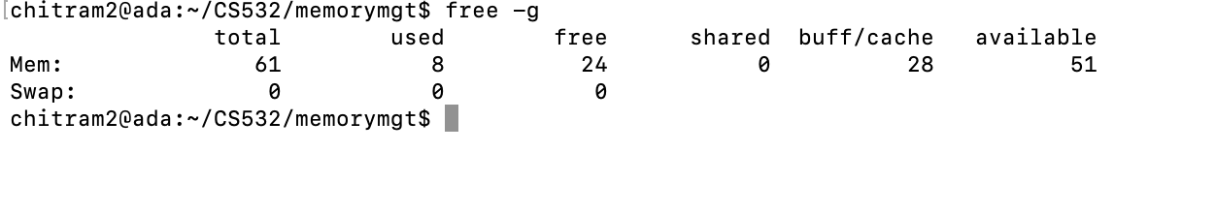
A. How much memory is in your system (in gigabytes)?
The total memory in the system is 61GB

Slide 6
B. How much is free?
The free memory in the system is 24GB

Slide 7
C. Do these numbers match your intuition?
These numbers match my intuition because the memory utilisation is moderate to high to achieve better efficiency in running the processes.

Slide 8
2. Write, compile and run a C program (call it cs532-memory-user.c) that uses a known amount of memory. This program should take one command line argument: the number of megabytes of memory to allocate. When run, it should allocate an array of this size and repeatedly iterate through the array, touching each entry. The program should do this indefinitely until the user stops it with Ctrl-C.
Add a new slide (or multiple) showing your code. Or copy your code to your submissions folder and include a link to it <HERE>.

Slide 9
#include <stdio.h>
#include <stdlib.h>
int main (int argc, char *argv[])
{
if (argc == 2){
printf ("The first argument is %s\n", argv[0]);
printf ("The second argument is %s\n", argv[1]);
}
else if (argc > 2){
fprintf(stderr, "Too many arguments.\n");
return -1;
}
else{
fprintf(stderr,"More arguments expected.\n");
return -1;
}
long long int size = (long long int) atoi(argv[1]);
long long int size_in_bytes = size * 1024 * 1024;
printf("allocating %lld bytes (%.2f MB)\n",size_in_bytes, size_in_bytes / (1024 * 1024.0));

Slide 10
int *x = malloc(size_in_bytes);
if (x == NULL) {
fprintf(stderr, "memory allocation failed\n");
return -1;
}
long long int num = size_in_bytes / sizeof(int);
printf(" number of integers in array: %lld\n", num);
long long int i = 0;
for (i = 0; i < num; ++i){
x[i] = i + 1;
}
while (1){
for (i = 0; i < num; ++i){
x[i] = x[i] + 1;
}
}
return 0;
}

Slide 11
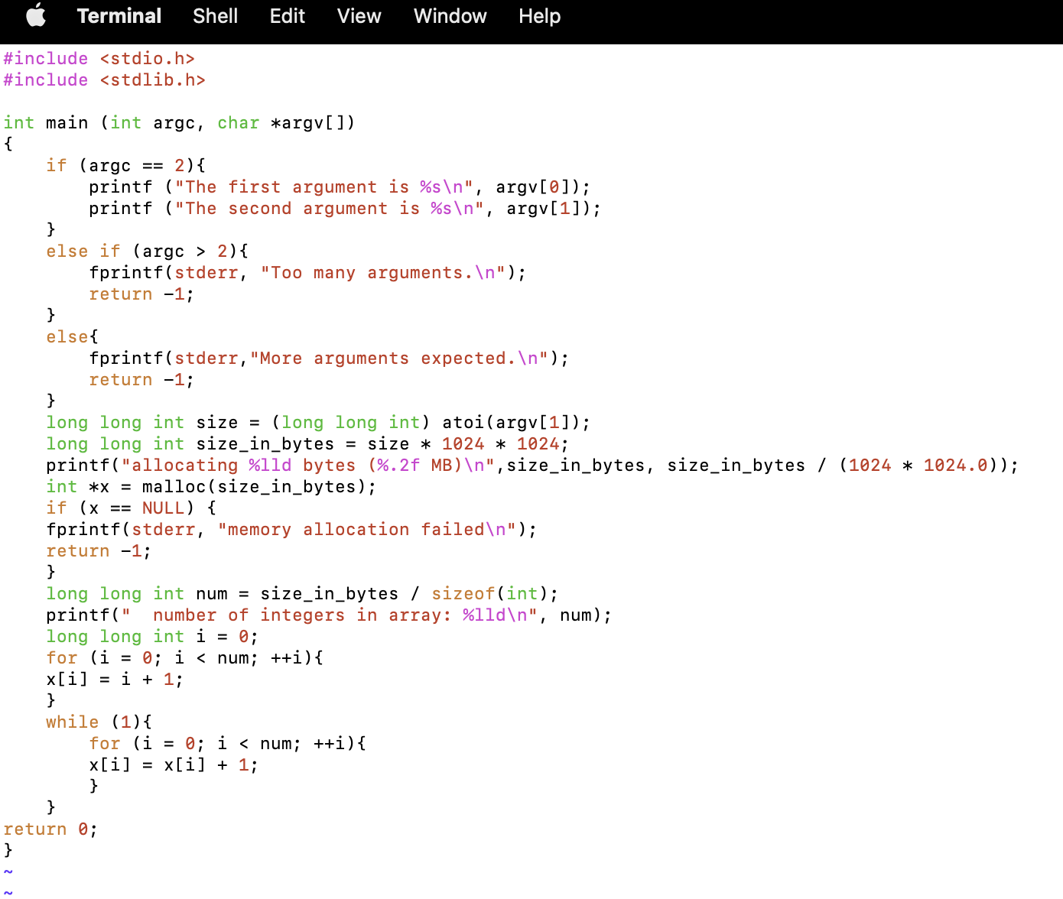

Slide 12
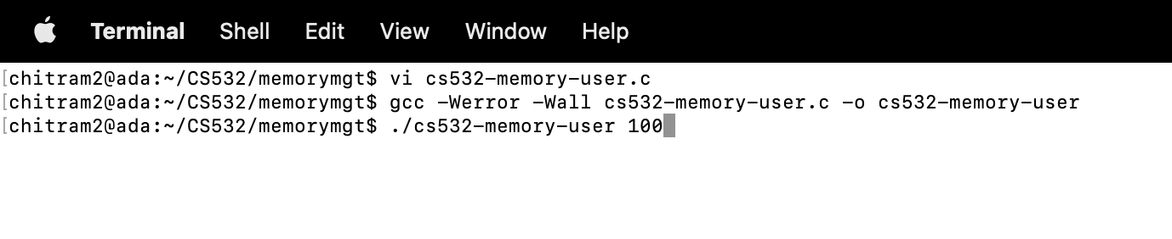
Compiling and running the program

Slide 13
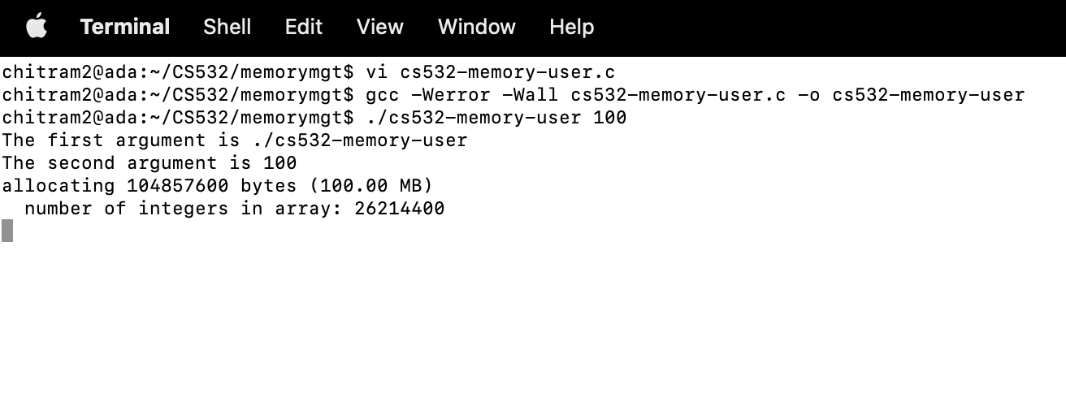
Loop will assign the elements and iterate it infinitely till ctrl+c is inputted

Slide 14
3. Now, while running your cs532-memory-user program, also (in a different terminal window, but on the same machine) run the free tool.
A. How do the memory usage totals change when your program is running?
B. How about when you terminate the cs532-memory-user program? Do the numbers match your expectations?

Slide 15
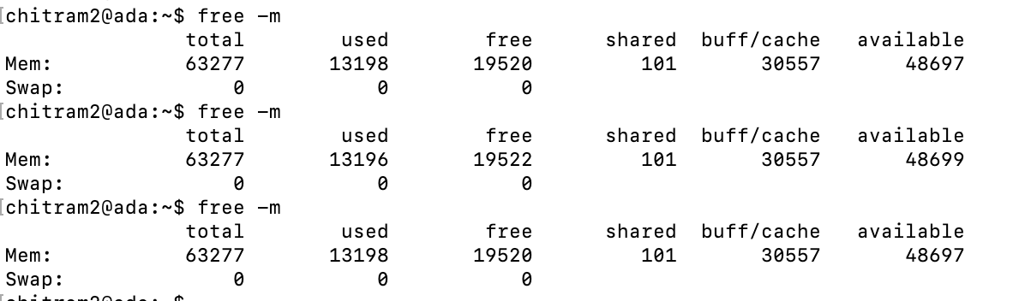
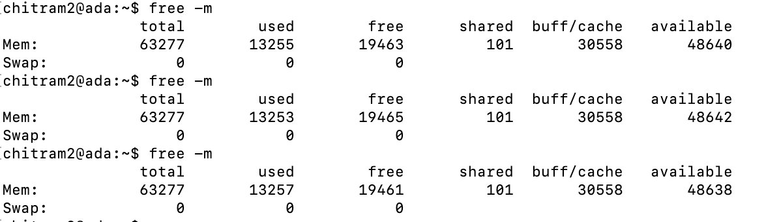
A. How do the memory usage totals change when your program is running?
Memory usage before program execution
Memory usage during program execution - Used memory increases and free memory decreases. Slight variation in used and free memory from time to time

Slide 16
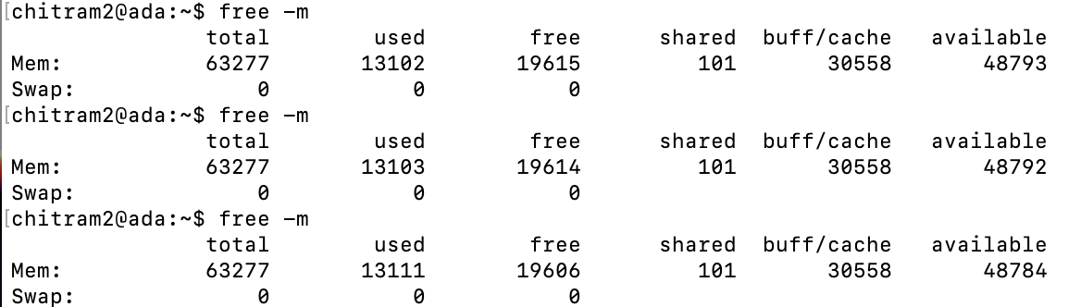
B. How about when you terminate the cs532-memory-user program? Do the numbers match your expectations?
Memory usage after program terminated
Used memory decreases and free memory increases. Does not exactly match values from first capture (obtained before running cs-532-memory-user program). But as expected free memory increased after cs-532-memory-user program killed

Slide 17
C. Fill the following table using your cs532-memory-user program and the free utility. Record the amount of free memory (in megabytes) before, during and after running cs532-memory-user utilizing each corresponding amount of memory.
 | before | during | after
10 MB | 34460 | 34269 | 34314
100 MB | 34300 | 34205 | 34293
1 GB | 34316 | 33240 | 34303
10 GB | 34269 | 23682 | 33952
100 GB(memory allocation failed Total memory of system is 61Gb) | 34073 | 34589 | 34592

Slide 18
To use pmap, you must know the ID of the process to monitor. So, first run your cs532-memory-user program in one terminal window (ask it to allocate 100 megabytes). Then, in a separate terminal window, run ps auxw to see a list of all processes. Within that list, find your running cs532-memory-user program and its pid.
Use pmap to print out the memory map of your cs532-memory-user program.
Output:
USER PID %CPU %MEM VSZ RSS TTY STAT START TIME COMMAND
chitram2 2392414 99.0 0.1 105176 103876 pts/70 R+ 23:28 2:33 ./cs532-memory-user 100

Slide 19
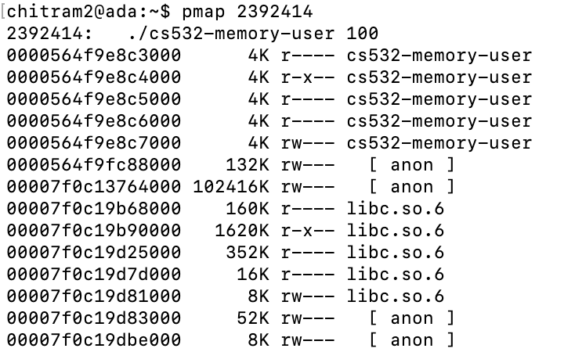
4. Copy and paste a screen capture of the first 10 lines of your pmap output.

Slide 20
5.
A. How many mappings make up the process map for your cs532-memory-user program?
23 mappings
B. What is the smallest size of any mapping shown by pmap?
4 Kb

Slide 21
C. List the 5 largest mappings along with their sizes.
Mapping name | Size (in kilobytes, as reported by pmap)
anon | 102416K
libc.so.6 | 1620K
libc.so.6 | 352K
libc.so.6 | 160K
ld-linux-x86-64.so.2 | 168K

